Slide 1





Team Details
Team name: ADROIT
Team leader name: Nawaz B. Sayyad
Problem Statement: PS-1- Enhancing Cybersecurity with Targeted Vulnerability Prevention(Business Logic Vulnerability Detection, Fraud Prevention, and Rapid Response System for Banking)
India’s 1st Meta Llama Hackathon
Top 15. AI.Meta
AWS Ideathon 3rd Ranker
GCEK IDEATHON
Special Appreciation

Slide 2
The Escalating Threat of Dynamic Fraud in Banking Systems
In today’s banking infrastructure, security vulnerabilities such as SQL injection, broken authentication, and unauthorized access have become prevalent, creating significant risks. Fraudsters have adapted, using VPNs, broad proxies, and fake email IDs, masking their identities while exploiting weak security mechanisms. These threats are not only constant but evolve rapidly, making it harder for traditional systems to keep up.
Consider the following patterns:
Sim Card Switching & Remote Transactions: A fraudster hijacks a user’s SIM and initiates transactions from an unexpected location, triggering security alerts after the transaction is completed, often too late to stop the fraud.
Double Fraud Scams: Scammers start by offering small returns (e.g., 4000 INR) and increase the offer drastically (e.g., 8000 INR), manipulating victims into investing larger amounts, only to scam them.
Authorization Hijacking & Account Takeovers: Attackers exploit weak authentication to gain control over bank accounts, with automated scripts attempting thousands of login credentials per minute through brute force methods.
SQL Injection and Database Manipulation: Insecure databases are targeted with injections, allowing attackers to steal, alter, or delete data silently.
The Impact is Alarming: Fraud is evolving faster than detection systems can respond. By the time one fraud pattern is detected, 3-4 victims may have already suffered from the same technique. 80% of fraud attacks go undetected for several hours or even days due to slow response systems, allowing attackers to escape with millions.
The Speed of Response is Key: Currently, many systems only react after fraud is identified, leading to delays in detection and prevention. This gap is critical; with the growing complexity of scams, a slow response time means higher risks for both customers and the bank.
The need for a faster, real-time response mechanism is crucial to stop the escalating trend of fraud. Without it, banking infrastructure will continue to be vulnerable to a growing number of sophisticated scams.

Slide 3
Opportunities
1.How different is it from any of the other existing ideas?
My solution is different because it provides Rapid, intelligent, and adaptive defense against the ever-evolving nature of fraud in banking systems, ensuring that financial institutions stay ahead of fraudsters, rather than simply reacting to them.
Moreover, it is designed to seamlessly integrate with live banking servers without requiring extensive changes or high additional costs, apart from the necessary hardware. This ensures a smooth implementation and minimal disruption to ongoing operations, offering banks a cost-effective, real-time fraud detection system that enhances security and protects against emerging threats.
2.How will it be able to solve the problem?
Our solution solves the problem by providing real-time fraud detection that monitors transactions for patterns like unusual amounts, location changes, and SIM swaps. As the fraud detection rate increases, the system aggregates key data such as IP address and transaction history, triggering rapid escalation.
Once fraud is detected, the system immediately alerts authorities, blocks suspicious transactions, and auto-generates a report with key details. It can even call the victim, transfer them to the cyber department, and direct security teams to investigate on-site.
This automated, rapid response ensures quick action, minimizing fraud impact and providing continuous protection with seamless integration into existing banking infrastructure, all at a low cost
3.USP of the proposed solution
The USP of our solution lies in its real-time fraud detection and instant automated response. It learns from evolving fraud patterns, rapidly blocking transactions, alerting authorities, and triggering investigations—all without disrupting existing systems.
With seamless integration, low cost, and adaptive intelligence, it provides proactive protection, staying ahead of fraudsters.

Slide 4
List of features offered by the solution : Z+ Guard
Real-Time Fraud Detection: Monitors and identifies suspicious patterns (e.g., SIM swaps, location anomalies, double fraud).
Automated Response: Instantly blocks fraudulent transactions and escalates alerts to authorities.
Adaptive Learning: Continuously adapts to emerging fraud patterns, staying ahead of fraudsters.
Data Aggregation: Combines critical transaction data (e.g., IP address, history) for enhanced detection accuracy.
Rapid Escalation: Automatically triggers reporting, investigation alerts, and cybersecurity team notifications.
Victim Call Automation: Contacts victims, verifies incidents, and transfers calls to the cyber department for immediate action.
Seamless Integration: Easily integrates with existing banking infrastructure without significant costs or disruptions.
Scalable Protection: Ensures long-term, scalable defense as new fraud patterns emerge.
Low-Cost Deployment: Requires minimal extra hardware, making it cost-effective to deploy in live banking systems.

Slide 5
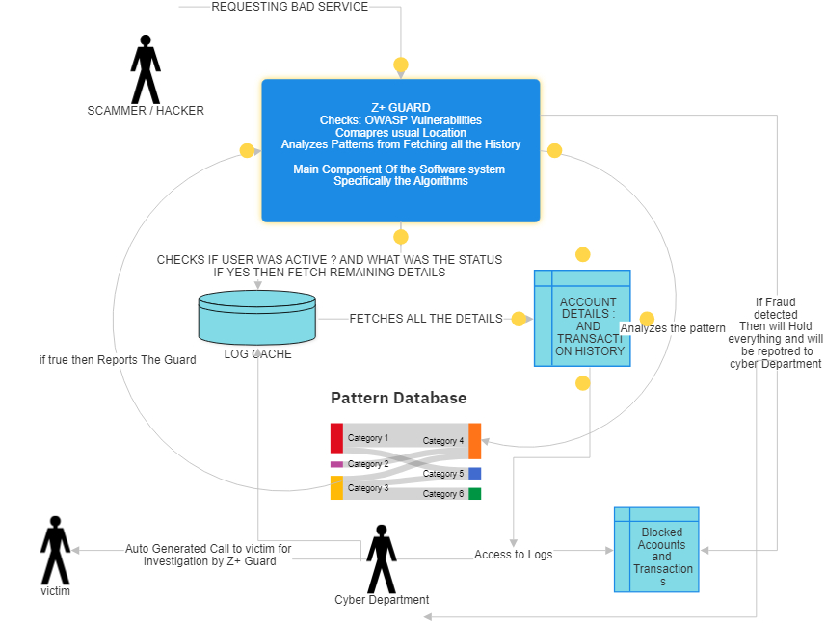
Process flow diagram

Slide 6
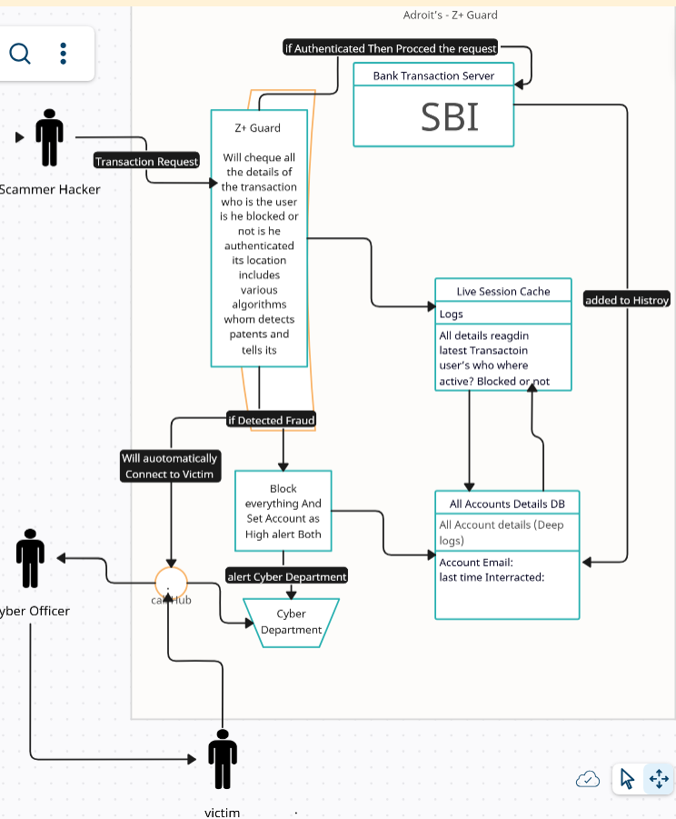
Architecture diagram of the proposed solution

Slide 7
Technologies to be used in the solution
Category | Tools/Technologies
Programming | Python, C#.NET (optional)
Machine Learning | Scikit-learn, PyTorch, Prophet
Caching | Redis
Databases | PostgreSQL, MongoDB, InfluxDB
Location Tools | OpenStreetMap, GeoIP2
Security | JWT, OpenSSL, OAuth2
Monitoring | Grafana
Logging | ELK Stack (Elasticsearch, etc.)

Slide 8
Estimated implementation cost (Only CacheMemory Can be Considered and Other Zero)
Implementation Cost Overview(Worst Case)
Using open-source technologies significantly reduces the software licensing and tool costs. The primary expenses are associated with hardware, especially high-speed RAM for caching billions of transactions and NVMe SSDs for fast storage. A high-performance server is also required to handle the processing load efficiently. Optional cloud services may incur minor costs if used for deployment or testing. Here's a detailed breakdown:
Cost Breakdown Table
Component | Estimated Cost (₹)
High-Speed RAM (for Log Cache) | 50,000–1,00,000
Storage (NVMe SSDs) | 60,000–80,000
Server Hardware | 2,00,000–3,00,000
Cloud Services (optional) | 12,000–30,000
Grand Total | 3,22,000–5,10,000
Summary
By leveraging open-source tools like Redis for caching, PostgreSQL for databases, and ELK Stack for logging, the project avoids software licensing fees. The main cost is focused on acquiring hardware to ensure high performance and scalability. Depending on the scale of deployment, the total cost is estimated to be between ₹3,22,000 and ₹5,10,000. If additional cloud infrastructure is needed, minimal monthly expenses can be expected.

Slide 9
Dear SBI Hackathon Team,
I sincerely thank you for taking the time to review my project and providing me with this incredible opportunity to present my ideas. It was truly an honor to showcase my work to such a prestigious panel.
As a student currently managing my exams, I have given my absolute best to analyze and develop this project, ensuring it aligns with real-world needs and adds value to the banking system. I am confident that this solution has the potential to make a meaningful impact and serve as a reliable tool in addressing the challenges it targets.
Your consideration and time are immensely valuable to me, and I deeply appreciate the opportunity to be part of this hackathon. I hope my project meets your expectations and earns your appreciation.
Thank you once again for your guidance, time, and support.
Warm regards, Nawaz Sayyad - Adroit

Slide 10
